Slide 1
Securing PaaS
Notes:
Information in this document, including URL and other Internet Web site references, is subject to change without notice. Unless otherwise noted, the example companies, organizations, products, domain names, e-mail addresses, logos, people, places, and events depicted herein are fictitious, and no association with any real company, organization, product, domain name, e-mail address, logo, person, place or event is intended or should be inferred. Complying with all applicable copyright laws is the responsibility of the user. Without limiting the rights under copyright, no part of this document may be reproduced, stored in or introduced into a retrieval system, or transmitted in any form or by any means (electronic, mechanical, photocopying, recording, or otherwise), or for any purpose, without the express written permission of Microsoft Corporation.
Microsoft may have patents, patent applications, trademarks, copyrights, or other intellectual property rights covering subject matter in this document. Except as expressly provided in any written license agreement from Microsoft, the furnishing of this document does not give you any license to these patents, trademarks, copyrights, or other intellectual property.
The names of manufacturers, products, or URLs are provided for informational purposes only and Microsoft makes no representations and warranties, either expressed, implied, or statutory, regarding these manufacturers or the use of the products with any Microsoft technologies. The inclusion of a manufacturer or product does not imply endorsement of Microsoft of the manufacturer or product. Links may be provided to third party sites. Such sites are not under the control of Microsoft and Microsoft is not responsible for the contents of any linked site or any link contained in a linked site, or any changes or updates to such sites. Microsoft is not responsible for webcasting or any other form of transmission received from any linked site. Microsoft is providing these links to you only as a convenience, and the inclusion of any link does not imply endorsement of Microsoft of the site or the products contained therein.
© 2018 Microsoft Corporation. All rights reserved.
Microsoft and the trademarks listed at https://www.microsoft.com/en-us/legal/intellectualproperty/Trademarks/Usage/General.aspx are trademarks of the Microsoft group of companies. All other trademarks are property of their respective owners.

Slide 2
Abstract and learning objectives
Abstract
This workshop is designed to provide exposure to many of Microsoft Azure’s PaaS security features. The goal is to show a secure end-to-end solution that addresses concerns around sensitive data, controlling access to sensitive stores of information, controlling access to production systems, and enabling secure processes for developers.
Learning objectives
Build secure solutions end to end with Azure PaaS services
Control access to PaaS service
Manage secrets and keys used by PaaS services

Slide 3
Step 1: Review the customer case study
Outcome
Analyze your customer needs
Timeframe
15 minutes

Slide 4

Customer situation
Fourth Coffee is an American coffeehouse chain that was founded in Seattle, Washington in 1970
They currently operate over 20,000 locations worldwide
Today, they provide gift-cards that customers can be purchased in-store and used at any of their locations

Slide 5
Customer situation
Currently they provide gift-cards that customers can purchase in-store and use at any of their locations
Gift-cards can be “re-loaded” with funds by payment by the customer as an in-store transaction
It currently operates over 20,000 locations worldwide
Improve their gift-card platform
Customers should be able to self-manage their gift-card collection, check balances, and in the future receive loyal customer benefits like free coffees or offers to try some of the newest bakery items
At this time, Fourth Coffee is not concerned with enabling customers to “re-load” their cards online
Enable cardholder to provide reviews about Fourth Coffee products

Slide 6
Customer situation
Already launched a customer profile microsite in Azure using Azure App Services
Host the website in a Web App and all logic is provided thru an API App
They want to keep this core approach for the gift-card website but extend it as appropriate with other Azure PaaS services
Looking to improve security and to gain visibility into security health of solution
Current site built with ASP.NET Identity Providers and stores the customer logins and passwords in Azure SQL Database
Improve process on how they limit and control access by their developers
Start with a single region pilot

Slide 7
Customer needs
Safeguard and manage identity of users and services
Detect and respond to identity based threats
Detect and respond to threats to their applications and solutions
Gain visibility into security health
Secure the loyalty data at rest and in transit, and allow access only to those who have a need
They want to achieve the right balance of security versus complexity
Security centered around PaaS services

Slide 8
Customer objections
Can we really set it up so our developers’ applications have access to the connection strings, keys, and other secrets at run time without enabling the developers themselves to access this sensitive data?
We’ve been told over and over again that Azure’s services like Azure SQL Database and Azure Storage must always have a public endpoint. Is that really true?
We heard the announcement about Managed Service Identity. We recognize it is in preview now, but we would like to understand how it would improve the security of the solution you are recommending to us.
We need to be certain that all of our data is encrypted when it is stored on disk. Is that possible with the PaaS services you are recommending?

Slide 9
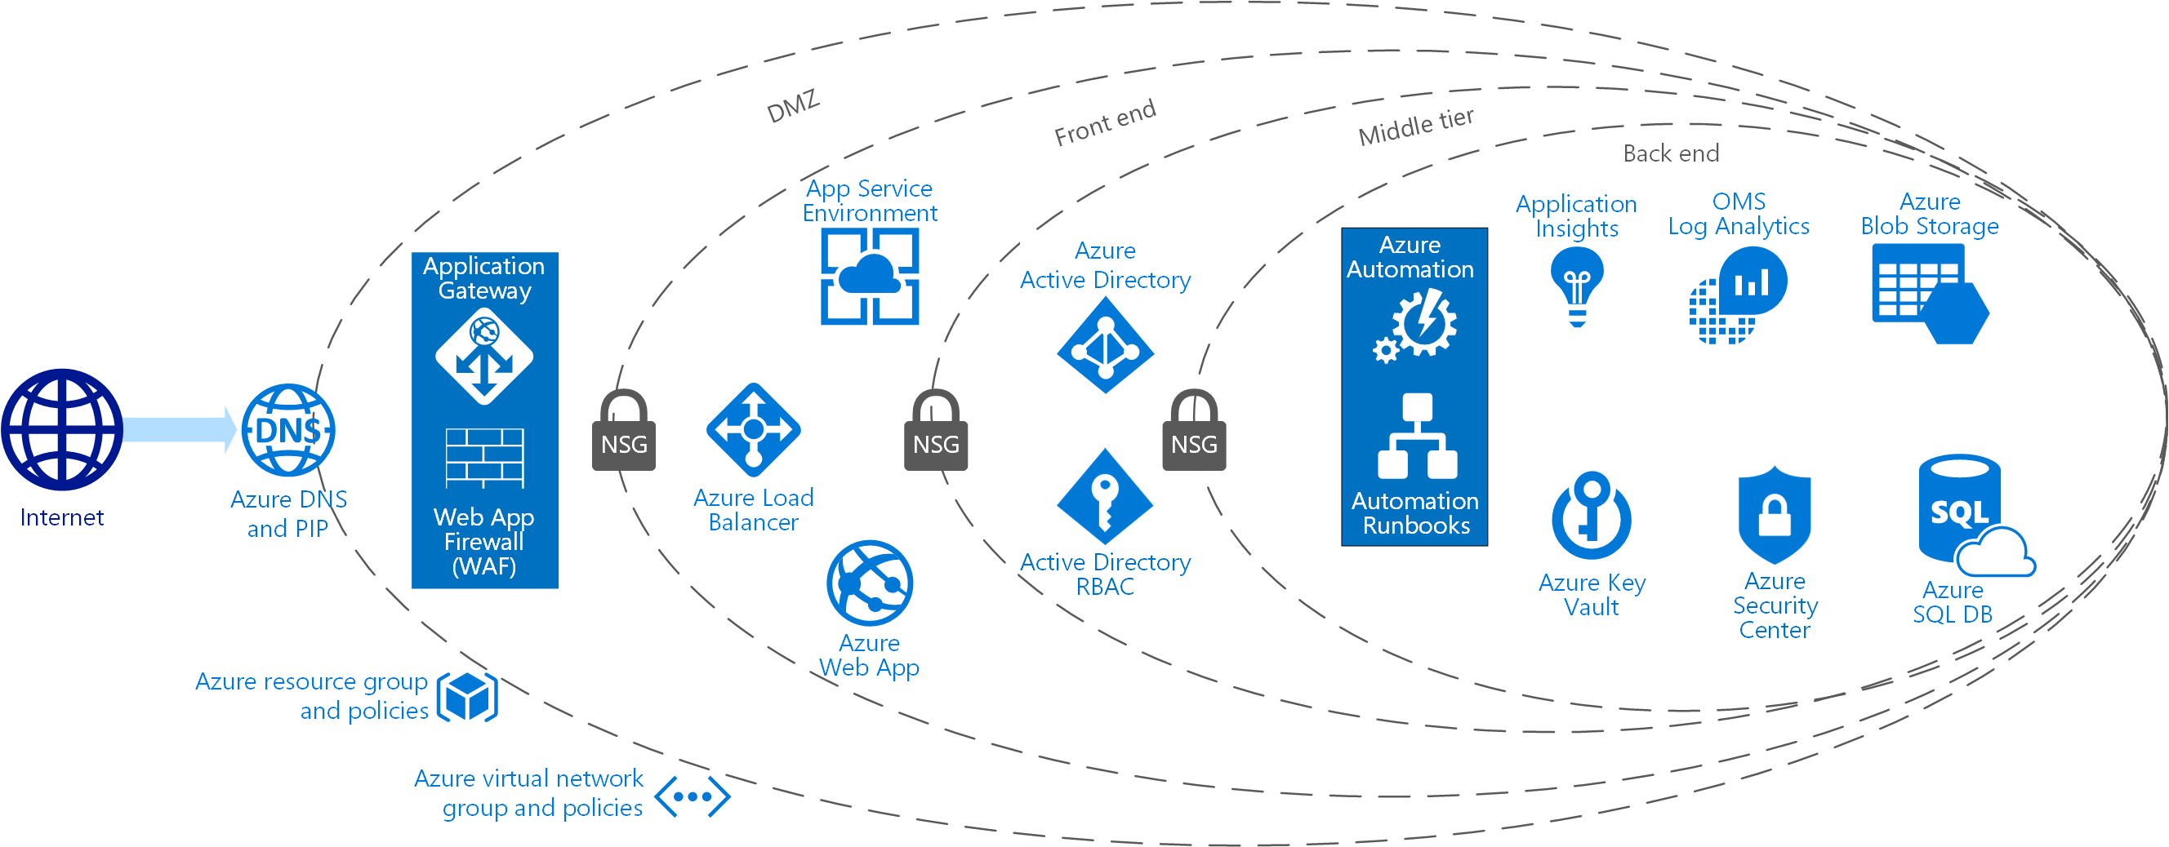
Common scenarios
Notes:
A layered approach to security with a solution that uses Azure PaaS services.

Slide 10
Step 2: Design the solution
Outcome
Design a solution and prepare to present the solution to the target customer audience in a 15-minute chalk-talk format.
Timeframe
60 minutes
Business needs (10 minutes) | Respond to questions outlined in your guide and list the answers on a flipchart.
Design (35 minutes) | Design a solution for as many of the stated requirements as time allows. Show the solution on a flipchart.
Prepare (15 minutes) | Identify any customer needs that are not addressed with the proposed solution. Identify the benefits of your solution. Determine how you will respond to the customer’s objections. Prepare for a 15-minute presentation to the customer.

Slide 11
Step 3: Present the solution
Outcome
Present a solution to the target customer in a 15-minute chalk-talk format.
Timeframe
30 minutes (15 minutes for each team to present and receive feedback)
Directions
Pair with another table
One table is the Microsoft team and the other table is the customer
The Microsoft team presents their proposed solution to the customer
The customer asks one of the objections from the list of objections in the case study
The Microsoft team responds to the objection
The customer team gives feedback to the Microsoft team

Slide 12
Wrap-up
Outcome
Identify the preferred solution for the case study
Identify solutions designed by other teams
Timeframe
15 minutes

Slide 13
Preferred target audience
Victoria Gray, CEO of Fourth Coffee
The primary audience is the business decision makers and technology decision makers. Usually we talk to the infrastructure managers who report to the chief information officer (CIO), or to application sponsors (like a vice president [VP] line of business [LOB], or chief marketing officer [CMO]), or to those that represent the business unit IT or developers that report to application sponsors.

Slide 14
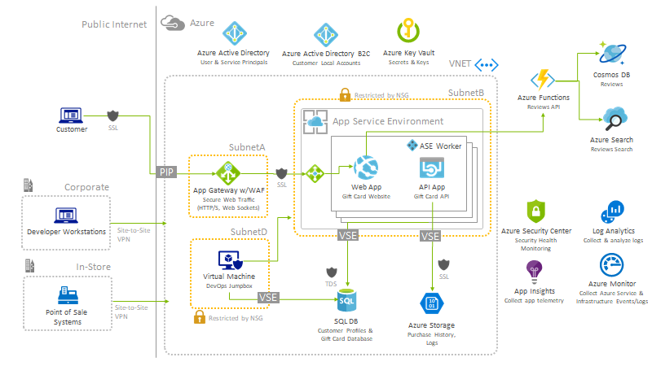
Preferred solution - High-level architecture

Slide 15
Preferred solution - High-level architecture
What data would you consider sensitive in this scenario? Is there a compliance standard that you would recommend Fourth Coffee consider building their solution against?
The gift card information is a financial instrument and should be secured following a similar approach how credit card holder data is protected
Recommend Fourth Coffee design their solution with the goal of achieving PCI DSS 3.0 compliance in mind
Microsoft provides a blueprint for Payment Processing for PCI DSS-compliant environments, which would serve as useful reference in designing the solution: https://docs.microsoft.com/en-us/azure/security/blueprints/payment-processing-blueprint https://docs.microsoft.com/en-us/azure/security/blueprints/payment-processing-blueprint

Slide 16
Preferred solution - Securing customer identity
What approach would recommend they take to modernize their customer identity management?
They should “outsource” the identity management function to Azure Active Directory B2C instead of storing usernames and passwords in the Fourth Coffee SQL Database
Would the approach you suggested still allow customers who do not want to use social accounts to create a login with Fourth Coffee?
Yes, AAD B2C enables applications to authenticate:
Social accounts (e.g., Facebook, Google, LinkedIn)
Enterprise accounts (e.g., integrated using open standard protocols, OpenID Connect or SAML)
Local accounts (e.g., email address and password or username and password)
Customers who do not want to use their social accounts could use local accounts in AAD B2C

Slide 17
Preferred solution - Securing customer identity
How would you address their self-service password reset requirement? What is the process?
AAD B2C provides a self-service password reset feature for users who have setup local accounts.
Once self-service password reset is enabled in Active Directory, when a user arrives at a login screen a link labeled “Can’t access your account?” appears. The consumer needs to enter their email address. If the email address belongs to a valid user, that address will be sent an email with a link allowing the recipient to reset the password.

Slide 18
Preferred solution - Securing the core website components
The Fourth Coffee website should be publicly accessible, but the gift-card API should not be accessible from the Internet. Additionally, all traffic flowing thru to the website should pass thru a firewall to guard against malicious requests like cross-site scripting and SQL injection, and the website itself should never be directly accessible in any other way. How would you accomplish this?
Host the website within a Web App
Host the API within an API App
These App Services should be hosted within an App Service Environment (ASE)
The ASE itself provides a hosting infrastructure that is deployed within a subnet of a Virtual Network (VNET)

Slide 19
Preferred solution - Securing the core website components (continued)
The Fourth Coffee website should be publicly accessible, but the gift-card API should not be accessible from the Internet. Additionally, all traffic flowing thru to the website should pass thru a firewall to guard against malicious requests like cross-site scripting and SQL injection, and the website itself should never be directly accessible in any other way. How would you accomplish this?
The ASE exposes only an Internal Load Balancer (ILB) endpoint for access to the App Service instances it hosts
An Application Gateway of the Web Application Firewall sku should be deployed between the public IP address used by Internet clients to access the website and the ILB ASE endpoint
The ASE and the Application Gateway are deployed to two different subnets
Network Security Groups (NSG) are configured so that the subnet that contains the ASE only allows access from the subnet which contains the Application Gateway

Slide 20
Preferred solution - Securing the core website components (continued)
Fourth Coffee does not like the fact that their existing SQL Database and Azure Storage which contain sensitive data have endpoints that are accessible on the Internet. What would you suggest and what is the process?
With VNET service endpoints for SQL Database and Azure Storage, Fourth Coffee can make their endpoints available within a VNET subnet and nowhere else, including removing the public endpoint.
For SQL DB, they would need to create a subnet for use by their database. Then within the VNET configuration they would need to add an endpoint for Microsoft.Sql and select the subnet in which they will allow access to the database.

Slide 21
Preferred solution - Securing the core website components (continued)
Fourth Coffee does not like the fact that their existing SQL Database and Azure Storage which contain sensitive data have endpoints that are accessible on the Internet. What would you suggest and what is the process?
Then they would need to configure the SQL server (which encapsulates the SQL Database) by selecting the VNET and subnet in which access should be allowed
Finally, they should create restricted access to the subnet by configuring an NSG on it. In this case, the NSG would need to allow access from the subnet containing the ASE
For Azure Storage, take a similar approach as they did for SQL Database: configure the VNET with an endpoint for Microsoft.Storage and select the subnet. Then in the Azure Storage account, they configure the firewalls and virtual networks feature to select the VNET and subnet from which access to the Storage account should be allowed.

Slide 22
Preferred solution - Securing the core website components (continued)
The existing API App is deployed with the connection string information to the SQL Database saved in the web.config. Fourth Coffee would like to improve the handling of sensitive configuration. What would you recommend they do and how would they need to change their app to support your recommendation?
Fourth Coffee should deploy Azure Key Vault
Select a Premium tier which will safeguard secrets like connections strings using specialized hardware security modules (HSM)
Access to Key Vault is secured using AAD principals, and Fourth Coffee would need to create a principal in AAD to represent the API App

Slide 23
Preferred solution - Securing the core website components (continued)
The existing API App is deployed with the connection string information to the SQL Database saved in the web.config. Fourth Coffee would like to improve the handling of sensitive configuration. What would you recommend they do and how would they need to change their app to support your recommendation?
In web.config, provide the Client ID and Client Secret from the AAD principal, as well as the Secret URI that identifies the secret in Key Vault
Add additional code that uses the Client ID, Client Secret, and Secret URI to retrieve the connection string from the Key Vault before it can be used to connect to SQL DB
The proper configuration of Key Vault involves setting ARM RBAC on the management plane of the Key Vault for the solution security group and enabling proper Key Vault access control for developers against the data plane. The solution audit group would also need data plane permissions to list secrets and keys, but not to view their contents or modify them.

Slide 24
Preferred solution - Enabling reviews
Fourth Coffee wants to be certain that their mini-platform for reviews can scale, and are less concerned about securing the data (other than securing access to edit the reviews appropriately). How would you suggest Fourth Coffee deploy the logic for managing and navigating reviews, and how would reviews (which could grow to become very large data sets) be stored?
Reviews are not sensitive data akin to the transaction data used by the gift cards
Host logic for querying and managing reviews in Azure Functions
In web.config, provide the Client ID and Client Secret from the AAD principal, as well as the Secret URI that identifies the secret in Key Vault
Using a consumption plan that would enable rapid scalability for executing operations
Review data would be stored in Cosmos DB

Slide 25
Preferred solution - Enabling reviews (continued)
Fourth Coffee would like users to be able to search across reviews with free-form text, but also narrow their search by product, date range, and number of stars. How would you enable end-users to search thru reviews?
Enabled by indexing the reviews data stored in Cosmos DB using Azure Search
An indexer can be configured that periodically updates the Azure Search index with new reviews that appear in Cosmos DB
How would you secure access to the services you propose in support of reviews?
Access to Azure Function, Cosmos DB, and Azure Search are secured with keys. These keys should be stored as secrets within Key Vault.

Slide 26
Preferred solution - Securing DevOps
How would you secure how developers interact with production systems for the purposes of deployments as well as troubleshooting?
When deploying code to a Web App or API App, developers are deploying using MSDeploy to endpoints of the form *.scm.myapp.com
What makes the SCM endpoint available via the Internet is the configuration of the Application Gateway, which evaluates host headers to direct traffic to the appropriate ASE backend
Configure the Application Gateway to route requests against the SCM.myapp.com to another URI (such as a not-found or not allowed page) so that they do not reach the back-end ASE

Slide 27
Preferred solution - Securing DevOps (continued)
How would you secure how developers interact with production systems for the purposes of deployments as well as troubleshooting?
There are two ways developers (or CI/CD tools automating the process) can be provided with access to deploy updates to production code: One option is for the developers to work across a site-to-site VPN that connect their office with the VNET in Azure. Another option is for a jumpbox to be deployed within the VNET that developers can use Remote Desktop Protocol (RDP) to access when they need access to production resources or perform deployments.
The NSG’s applied to the subnet containing the ASE and the VNET Service Endpoints (for SQL DB and Azure Storage) would need to explicitly allow access from the subnet representing the on-premises network or the subnet containing the jumpbox

Slide 28
Preferred solution - Securing DevOps (continued)
They would also like to restrict what developers can see in the database (in terms of sensitive data like gift-card data), what options do they have for this?
For the data stored in SQL Database, Fourth Coffee should consider configuring dynamic data masking on the sensitive data, enabling developers to troubleshoot without fully seeing sensitive values
They could also consider Column Level Encryption, which restrict the set of rows a developer would be allowed to see as the result of a query

Slide 29
Preferred solution - Monitoring security health
What services would you suggest Fourth Coffee utilize in order to monitor the general health of the solution?
Azure Monitor should use all monitoring data from Azure services, including performance metrics and events for PaaS services and management activities involving Azure Resource Manager (e.g., that captures when a resource is created, updated or deleted)
Application Insights to instrument applications like the website and API logic to collect performance monitoring data and user analytics telemetry
Log Analytics to ingest log and metric data from Azure Monitor and App Insights, and provide tools to query, analyze, and dashboard the integrated data

Slide 30
Preferred solution - Monitoring security health (continued)
What service would you suggest Fourth Coffee utilize to monitor the security health of the solution? What would it provide for their solution?
They should use Azure Security Center which will monitor their configuration and make security recommendations
For their Web Apps: Security Center will monitor for the presence of a web application firewall (WAF) and collect logs from the WAF
For their SQL DB: They should turn on auditing and threat detection on their SQL Database as threats will show up in Azure Security Center. Security Center will also flag any databases that do not have Transparent Data Encryption enabled.

Slide 31
Preferred objections handling
Can we really set it up so our developers’ applications have access to the connection strings, keys, and other secrets at run time without enabling the developers themselves to access this sensitive data?
Yes. For example, you can configure a situation where the web.config of the app refers to a secret (like a connection string) in Key Vault, but to get the value at runtime requires an AAD principal (e.g., it is an application service principal) that is not that of a developer.

Slide 32
Preferred objections handling
We’ve been told over and over again that Azure’s services like Azure SQL Database and Azure Storage must always have a public endpoint. Is that really true?
This used to be true. There is new functionality called VNET Service Endpoints that enables you to remove public endpoints for Azure SQL Database and Azure Storage and instead only have endpoints available within NSG secured VNET subnets that you indicate.

Slide 33
Preferred objections handling
We heard the announcement about Managed Service Identity. We recognize it is in preview now, but we would like to understand how it would improve the security of the solution you are recommending to us.
Managed Service Identity (MSI) creates an Azure service instance in Azure Active Directory that you can then manage like any other service principal. Each MSI enabled service has an internal mechanism to acquire its authentication token from AAD that it can present when identifying itself to the downstream systems and services it will call.
Notes:
For example, an Azure Function with an MSI will first make a request to a local endpoint to get the authentication token and then it can call Key Vault using that token to acquire a secret like a connection string. This feature is currently in preview and there is a limited set of services that provide a Managed Service Identity: Azure Virtual Machines, Azure App Service, Azure Functions and Azure Data Factory v2.

Slide 34
Preferred objections handling
We need to be certain that all of our data is encrypted when it is stored on disk, is that possible with the PaaS services you are recommending?
Yes. Azure Storage and Azure SQL Database provide the ability to toggle on transparent data encryption that encrypts data as it is written to the underlying storage. Cosmos DB and Search do not expose a mechanism to disable encryption, but all data is also automatically encrypted when written using Microsoft managed keys.
Notes:
For example, an Azure Function with an MSI will first make a request to a local endpoint to get the authentication token and then it can call Key Vault using that token to acquire a secret like a connection string. This feature is currently in preview and there is a limited set of services that provide a Managed Service Identity: Azure Virtual Machines, Azure App Service, Azure Functions and Azure Data Factory v2.

Slide 35
Customer quote
“I’m thrilled to open up these new gift-card capabilities to our loyal customers, knowing that they are built with productivity boosting solutions, on a foundation that is secure.”
- Victoria Gray, CEO of Fourth Coffee

